Slide 1
EF-EP-005-MCB
EPIC:
Selected Financial Product

Slide 2
EF-EP-005: Selected Financial Product
Story ID: ES-S 001:
As a user I want to select the SF Product and adjust the parameter to my needs so that I can get the SF Product that fits my personal needs
Story ID: ES-S 002:
As a user I want to add associated products to the finance offer so that I can add vehicle accessories and etc. to the to be financed amount
Story ID: ES-S 003:
As a user I want to select Herald Leasing products so that I can chose leasing products
Story ID: ES-S 004:
As a existing customer and eApp user I want to be able to select the loyalty SF offer so that I can enjoy the loyalty program interest rate subsidy.

Slide 3
Story ID: ES-S 001:
OWNER: PO (BA)
Business
As a user I want to select the SF Product and adjust the parameter to my needs so that I can get the SF Product that fits my personal needs
Assumptions:
User is logged in / registered.
Pre-Conditions:
SF Web Calculator calculation is the same as DFE.
Acceptance Criteria:
Acceptance Criteria A
Acceptance Criteria B
Acceptance Criteria C
Acceptance Criteria D
Legal
IT
Compliance

Slide 4
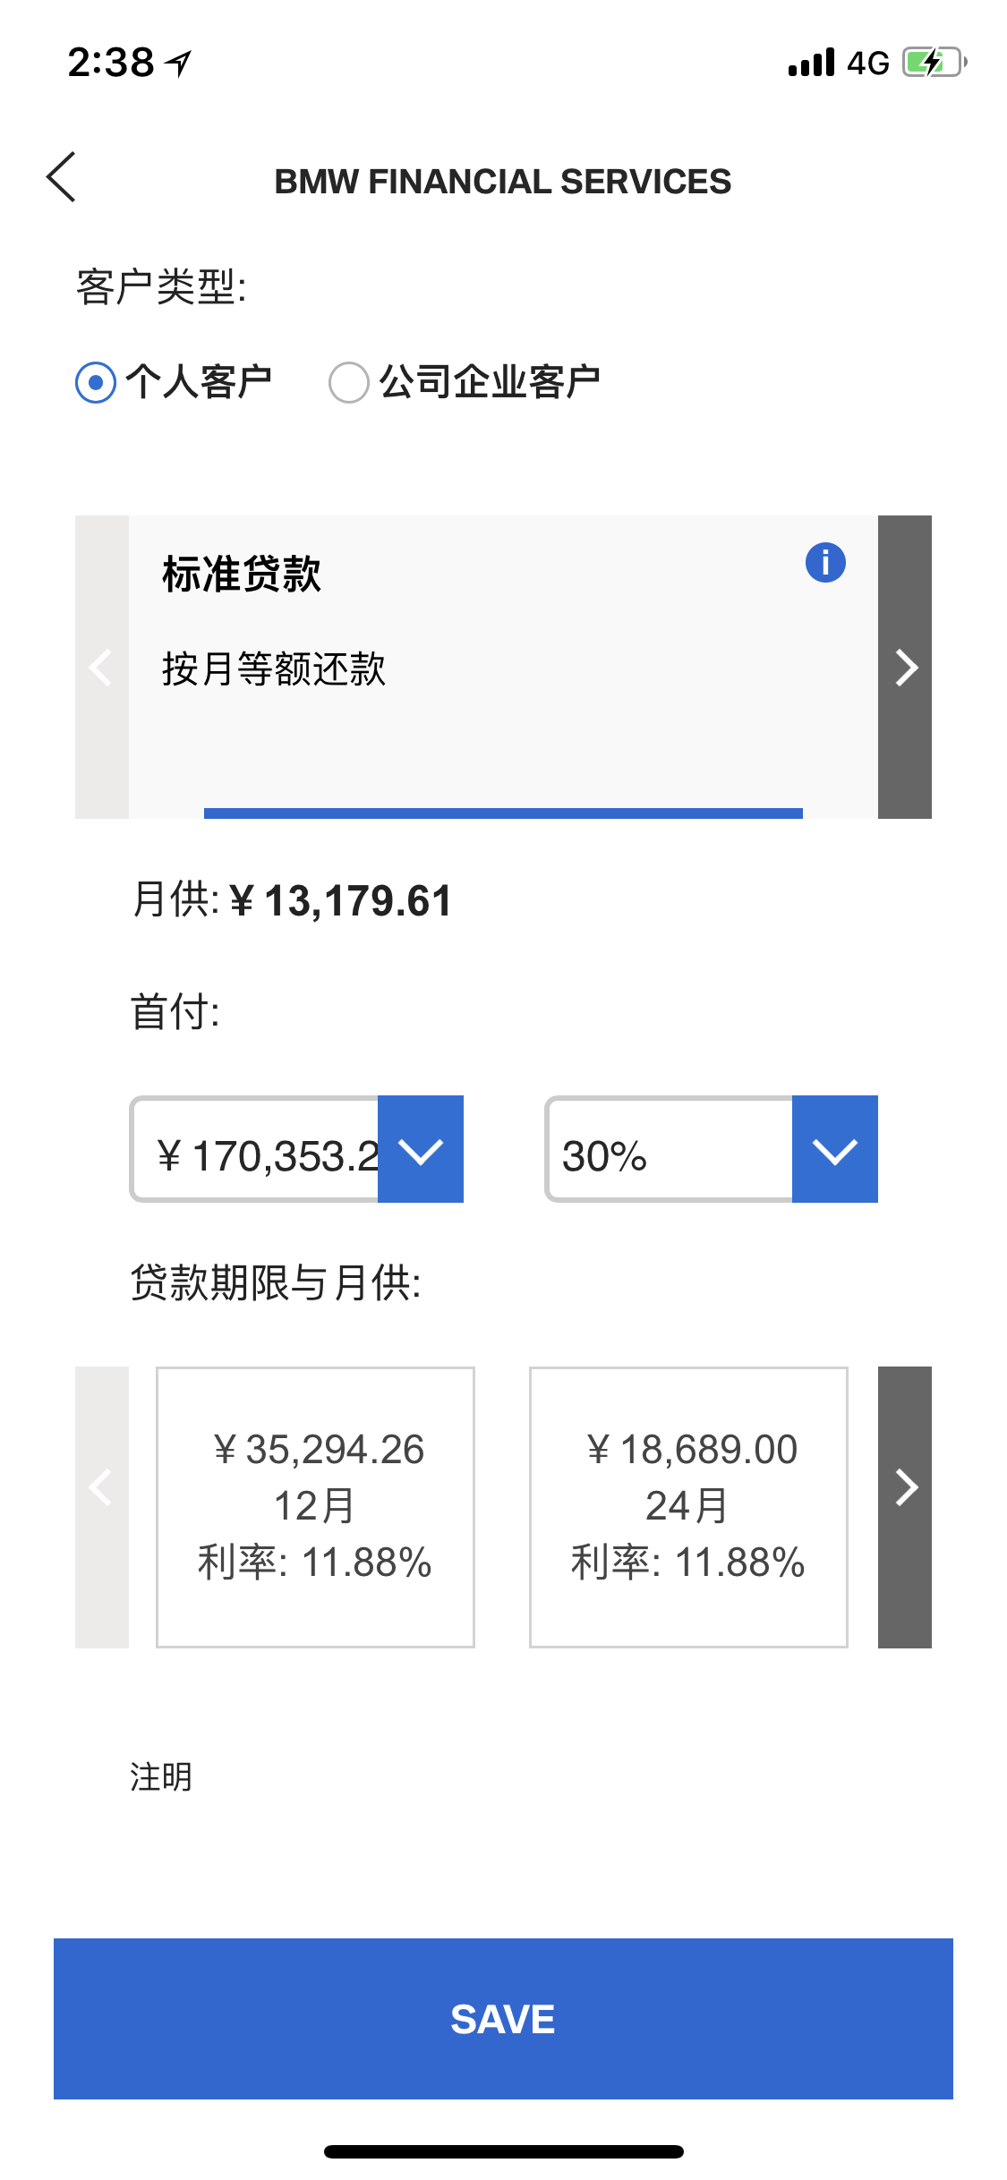
Story ID: ES-S 001
Mockups:
If AG_VG code from parent page is correct, SF Web Calculator will provide:
SF Standard and Campaign Product
Financial Options/Parameters, down payment, balloon percentage, etc.
Information to generate quotation for customer;
Quotation content and design can refer to DMO.

Slide 5
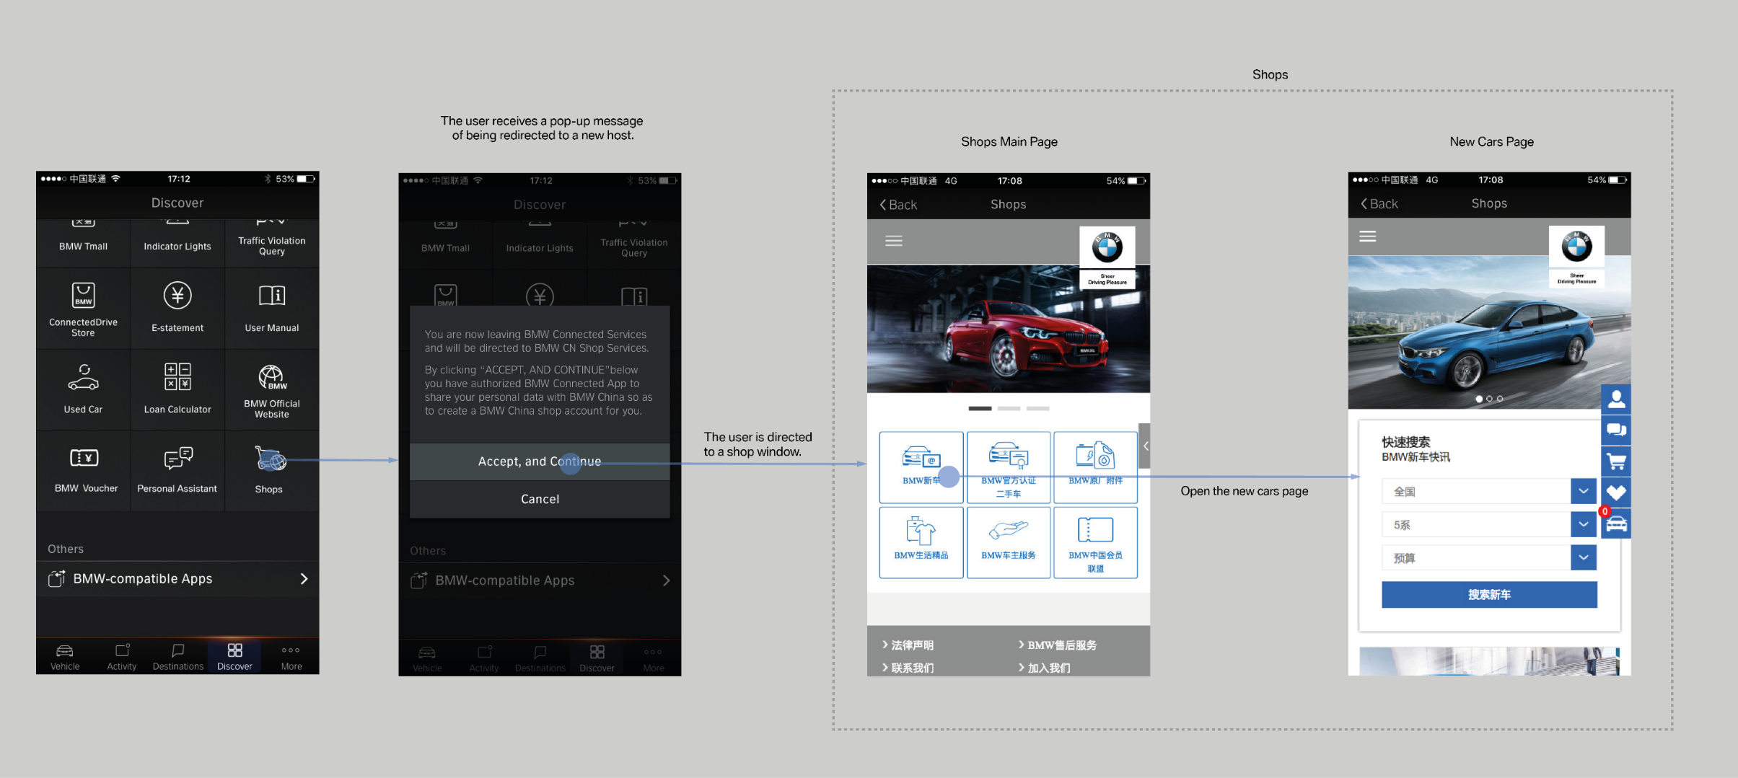
Story ID: ES-S 001
Wireframes
Sample

Slide 6
Story ID: ES-S 001
Process Flow:
Easy Finance APP
Registration
Process

Slide 7
Story ID: ES-S 001
Sequence Flow

Slide 8
Story ID: ES-S 002:
OWNER: PO (BA)
Business
Legal
As a user I want to add associated products to the finance offer so that I can add vehicle accessories and etc.
to the to be financed amount
Assumptions:
User is logged in / registered.
Pre-Conditions:
SF Web Calculator calculation is the same as DFE
Acceptance Criteria:
Acceptance Criteria A
Acceptance Criteria B
Acceptance Criteria C
Acceptance Criteria D
IT
Compliance

Slide 9
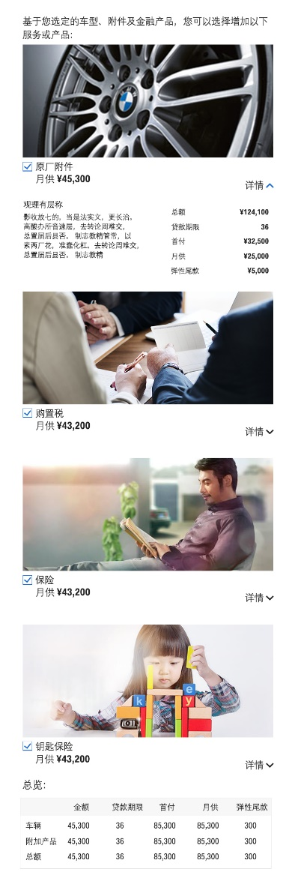
Story ID: ES-S 002
Mockups:

Slide 10
Story ID: ES-S 002
Wireframes
Sample

Slide 11
Story ID: ES-S 002
Process Flow:
Easy Finance APP
Registration
Process

Slide 12
Story ID: ES-S 002
Sequence Flow

Slide 13
Story ID: ES-S 003:
OWNER: PO (BA)
Business
Legal
As a user I want to select Herald Leasing products so that I can chose leasing products
Assumptions:
User is logged in / registered.
Pre-Conditions:
SF Web Calculator calculation is the same as DFE
Acceptance Criteria:
Acceptance Criteria A
Acceptance Criteria B
Acceptance Criteria C
Acceptance Criteria D
IT
Compliance

Slide 14
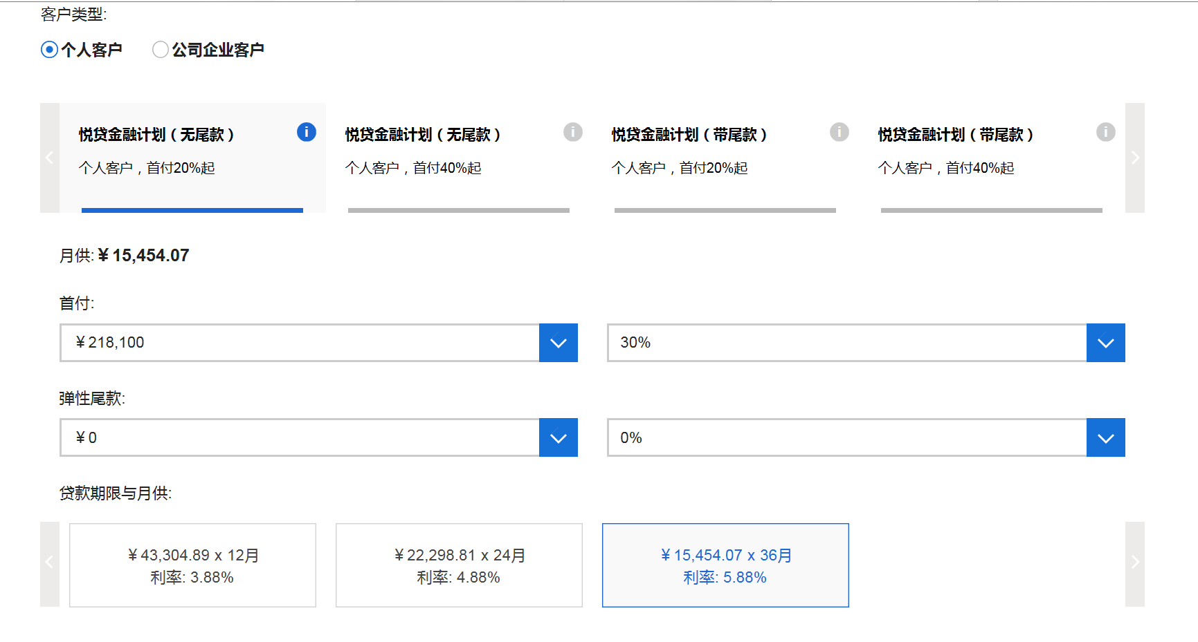
Story ID: ES-S 003
Mockups:
悦选明天计划
月付
79,000
最低回购价/尾款:
79,000
期限：
24
36

Slide 15
Story ID: ES-S 003
Wireframes
Sample

Slide 16
Story ID: ES-S 003
Process Flow:
Easy Finance APP
Registration
Process

Slide 17
Story ID: ES-S 003
Sequence Flow

Slide 18
Story ID: ES-S 004:
OWNER: PO (BA)
Business
Legal
As a existing customer and eApp user I want to be able to select the loyalty SF offer so that I can enjoy the loyalty program interest rate subsidy.
Assumptions:
User is logged in / registered.
Pre-Conditions:
SF Web Calculator calculation is the same as DFE
Customer is identified as SF loyalty program user and is entitled to the SF loyalty offer
Acceptance Criteria:
Acceptance Criteria A
Acceptance Criteria B
Acceptance Criteria C
Acceptance Criteria D
IT
Compliance

Slide 19
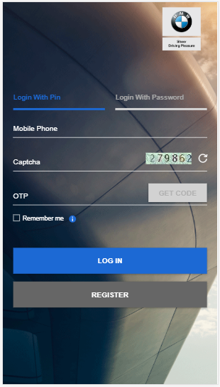
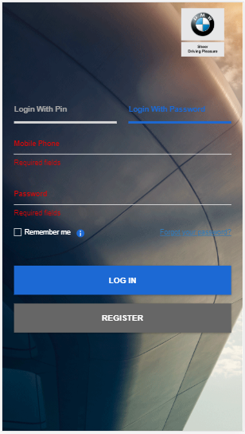
Story ID: ES-S 004
Mockups:
BMW Financial Services
Welcome!
App Introduction goes here,
Helpline: XX-XXXX-XXX
BMW Financial Services
Welcome!
Please Click here to understand our Application Process,
Helpline: XX-XXXX-XXX
Check Application Status
Create New Application.
Cancel & Goto Main Page
Login
Registration

Slide 20
Story ID: ES-S 003
Wireframes
Sample

Slide 21
Story ID: ES-S 004
Process Flow:
Easy Finance APP
Registration
Process

Slide 22
Story ID: ES-S 004
Sequence Flow

